Slide 1
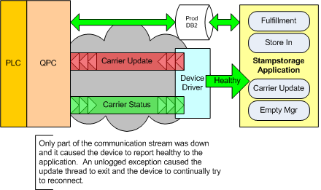
Dept
MFG/IT
IR #
1523300
OHCV Communication Issue
Rev. 1 8/09 JS/DC
Phase 1
Completed By:
Adam Kendell Incident Date: 09/10/2012
Phase 2
Problem:
OHCV partially stopped communicating to the QPC at 9:40AM.
Background: There was a VLAN blip that effected HMIN that could have contributed to this issue.
Root Cause:
The program thread responsible for building and tearing down network sockets exited with no logged error. Cause of this is still unknown.
Management Viewpoint:
There was no downtime. There was 3+ hours of impact to 4 stamping associates to manually move carriers and recovery afterward. Took over an hour to get OHCV restarted.
Detailed Impact: There was no downtime. The presses were not running or scheduled to run side panels. The application was intermittently able to move carriers. Four stamping associates manually and repeatedly reprocessed and moved carriers to weld from 10:00AM to 12:30PM.
Line #
N/A
Shift
A
Plant:
MAP
Counter Measure Category | Countermeasure Description | Schedule | Who
Quick Fix |  | 9/10/2012 10:49 AM | Steve Kieffer
TCM: |  | 9/10/2012 6:50 AM | Adam Kendell and IBM
PCM: |  | TBD | Adam Kendell and Ambica Gawarla
Identified Themes
N/A
Restarted the OHCV application.
Correct root cause
Need to improve response time for application restarts.

Slide 2
Timeline 9/10/2012
Time Who Event
9:39 AM stampstorage Last known report from the network device thread.
10:31 AM Billy Austin Stamping called to report an issue with carrier 244
10:49 AM Steve Kieffer Tried rebooting the QPC – Initially looked good - was able to update carriers
11:11 AM Steve Kieffer Stamping called to report that they're still having issues - Application partially down
11:17 AM Adam Kendell Began entering Sev 1 HEAT ticket to request an application restart from IBM
11:18 AM Adam Kendell Contacted Frank Masters to see if anyone was in who could help restart app
11:21 AM Adam Kendell Contacted CB to see if he can help.
11:23 AM Adam Kendell Called June Smith to see if anyone could help restart app - no answer didn't leave VM
11:24 AM Adam Kendell Finished sev 1 HEAT ticket and assigned to IBM INCIDENT RESPONSE
11:29 AM Adam Kendell Called Scott Reisner, left VM
11:41 AM Adam Kendell Called Bruce Drye, left VM
11:43 AM Adam Kendell Called IBM Swivel Desk to expedite the call – successful
---- Stamping Team Manually routing carriers to weld. App is still in a partial down state.
---- Adam Kendell / Ambica Gawarla hunting down root cause
12:30 AM Adam Kendell Reach Scott Reisner over IM
12:32 AM Adam Kendell IBM calls Adam Kendell
12:36 AM IBM App stopped
12:37 AM IBM / Adam Kendell App finished restarting – Issue is corrected

